Slide 1







Home
Video
About Us
Contact
PHISHING AWARENESS SIMULATION USING SOCIAL ENGINEERING TECHNIQUES
Ananta Pratap
(IIM Rohtak)
01

Slide 2

Home
Video
About Us
Contact
INTRODUCTION
Phishing is one of the most common cyberattacks.
Attackers use social engineering to trick users into revealing sensitive information.
Phishing emails often imitate legitimate organizations.
This project simulates a phishing attack to study user behavior.
02

Slide 3
Home
Video
About Us
Contact
OBJECTIVES
Understand phishing and social engineering techniques.
Design a simulated phishing email.
Create a fake login page.
Analyze how users respond to phishing attempts.
Suggest preventive measures for phishing attacks.
03

Slide 4

Home
Video
About Us
Contact
PHISHING & SOCIAL ENGINEERING
Phishing is a form of cyberattack that targets human behavior.
Attackers manipulate users through urgency or fear.
Common examples include fake password reset emails.
Social engineering techniques make phishing attacks effective.
04

Slide 5




Home
Video
About Us
Contact
METHODOLOGY
Studied common phishing techniques.
Designed a phishing email template.
Created a fake login page using HTML.
Hosted the page online using Netlify.
Collected user responses through Google Forms.
05

Slide 6
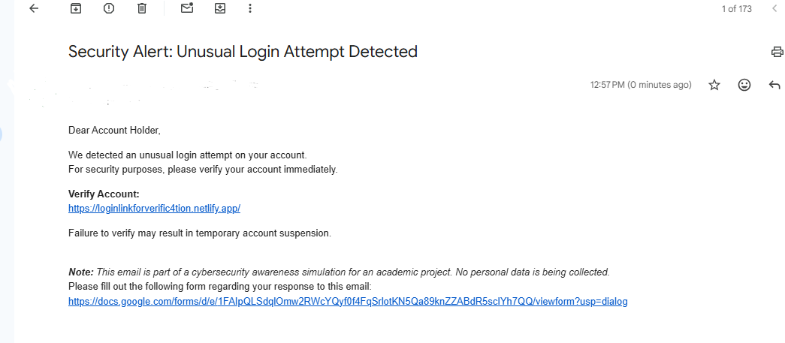
Home
Video
About Us
Contact
PHISHING EMAIL SIMULATION
Email designed to resemble a security alert.
Message asked users to verify their account.
Included a link directing users to a login page.
Demonstrates how phishing emails mimic legitimate messages.
06

Slide 7
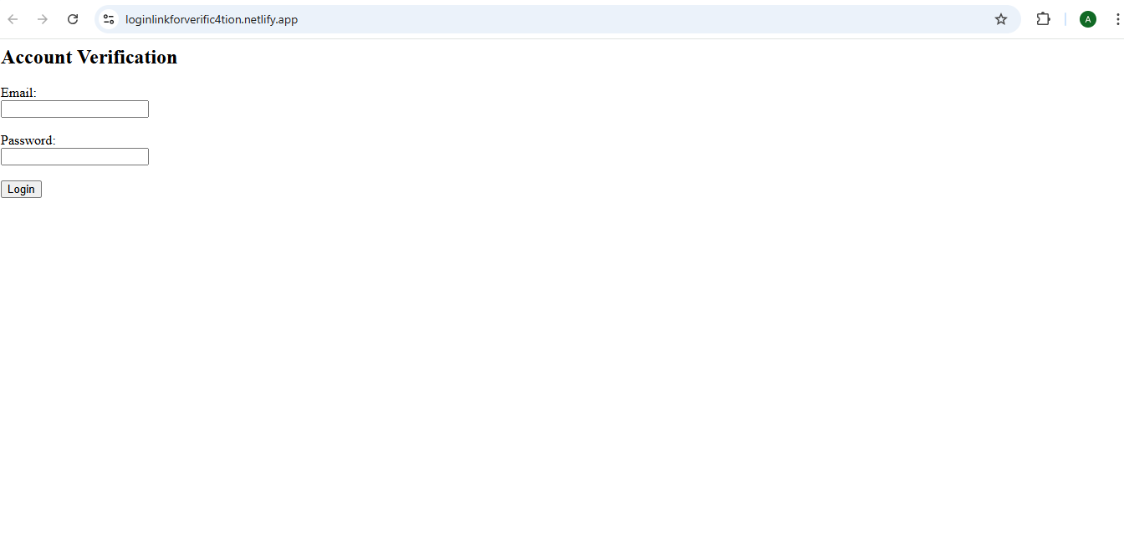
Home
Video
About Us
Contact
FAKE LOGIN PAGE
Login page created using HTML.
Hosted online using Netlify.
Contains email and password input fields.
Demonstrates how attackers imitate real login portals.
07

Slide 8
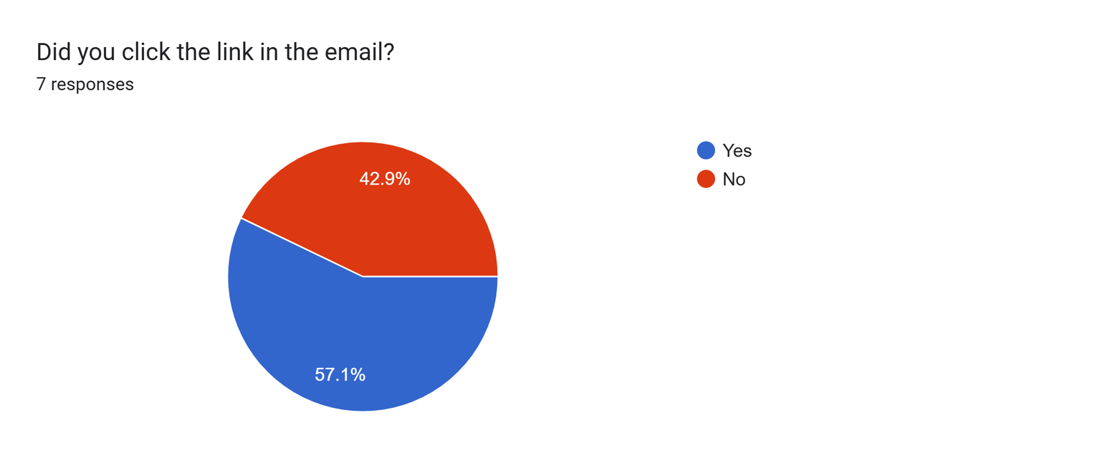

Home
Video
About Us
Contact
EXPERIMENT RESULTS
Clicked the link – 4
Did not click – 3
08

Slide 9
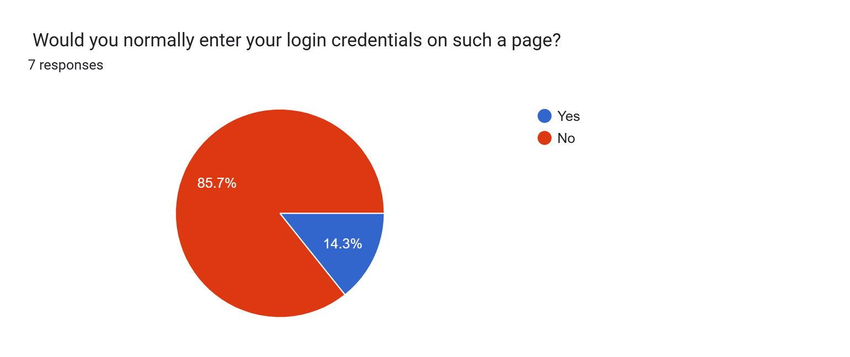
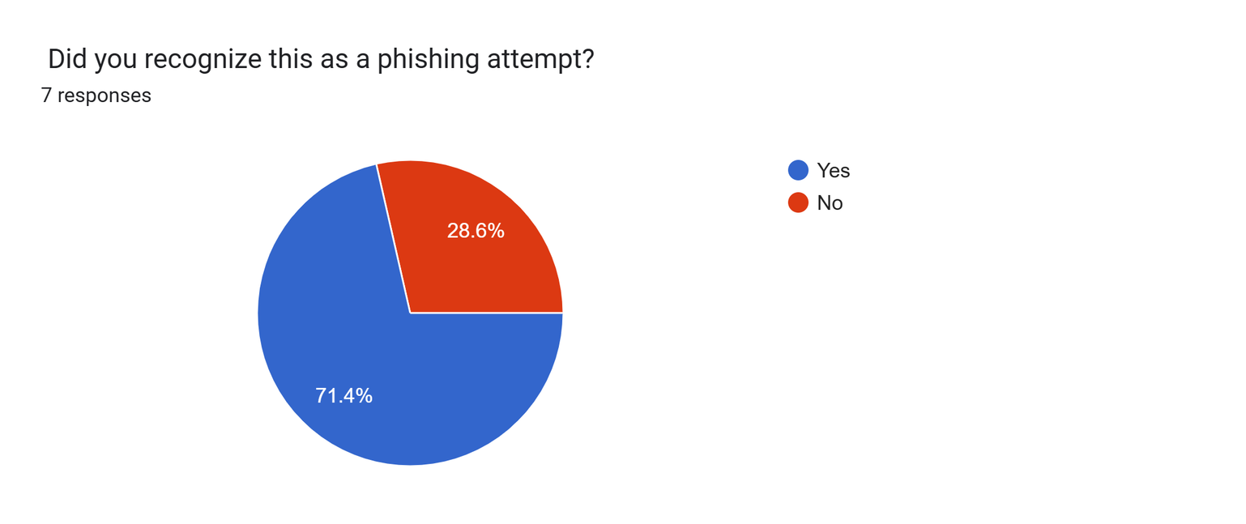
Home
Video
About Us
Contact
EXPERIMENT RESULTS
Recognized phishing attempt – 5
Would enter credentials – 1
08

Slide 10

Home
Video
About Us
Contact
CONCLUSION
Phishing attacks exploit human behavior.
Many users still interact with suspicious emails.
Awareness and training are essential for prevention.
Phishing simulations help educate users about cybersecurity risks.
05

Slide 11
Home
Video
About Us
Contact
THANK
YOU
Submitted by-
Ananta Pratap
(Indian Institute of Management, Rohtak)

